Slide 1
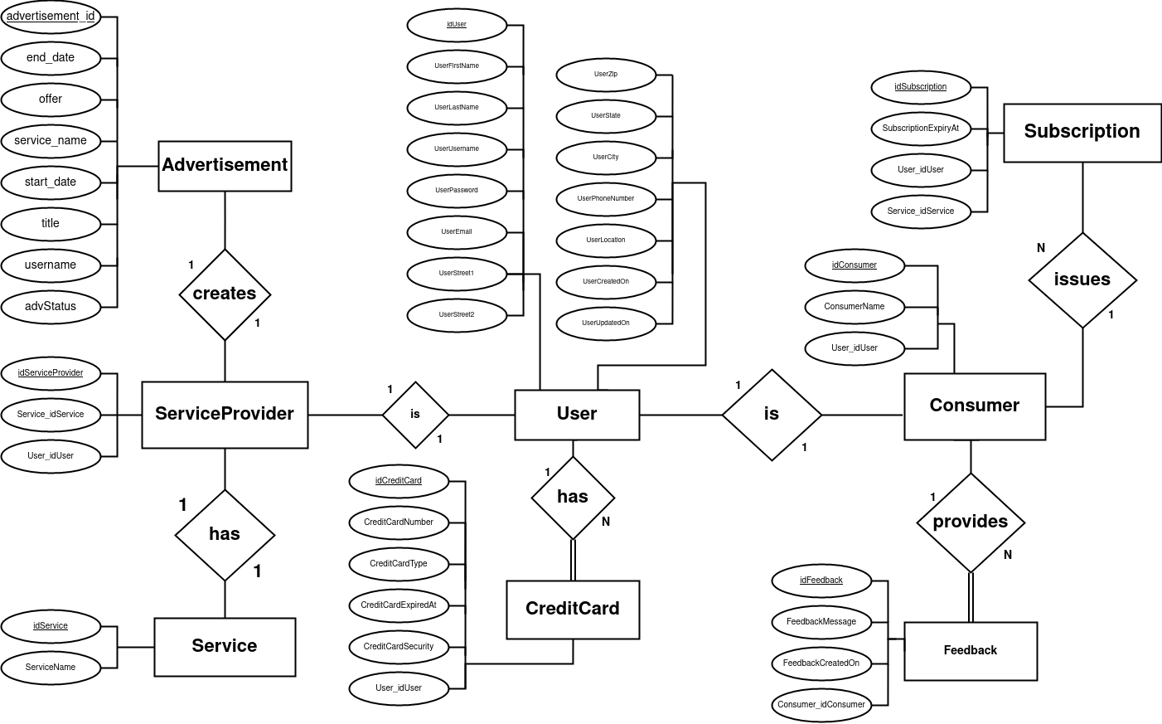
Servicegenerale’s
Conceptual
Entity-Relational
Diagram
11/17/21
Release: 2
Iteration: 3
Week: 11
Team: 3

Slide 2
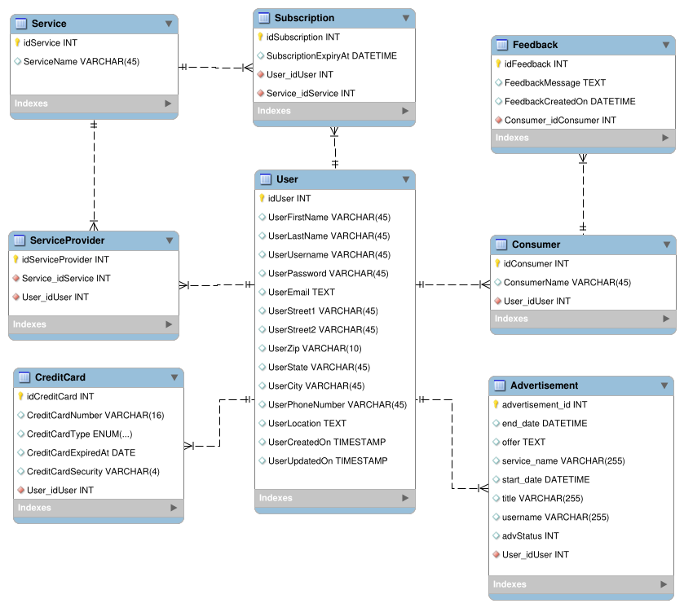
Servicegenerale’s
Logical
Entity-Relational
Diagram
11/17/21
Release: 2
Iteration: 3
Week: 11
Team: 3

